Slide 1
Kali Evil Twin
By Thomas Hamilton

Slide 2
Problem and Purpose
Data is vulnerable during transit, and malicious actors want to take advantage of it
By showing people how vulnerable it is may help them
Personal Reasons

Slide 3
Component Necessities
Kali Kernel <= 6.1
Airgeddon
A compatible USB wifi adapter
  https://github.com/v1s1t0r1sh3r3/airgeddon/wiki/Cards-and-Chipsets
Wireshark
Python

Slide 4
Set up
Normal Kali setup
Install airgeddon
Launch
Navigate the menu
Launch Wireshark
Launch Evil Twin

Slide 5
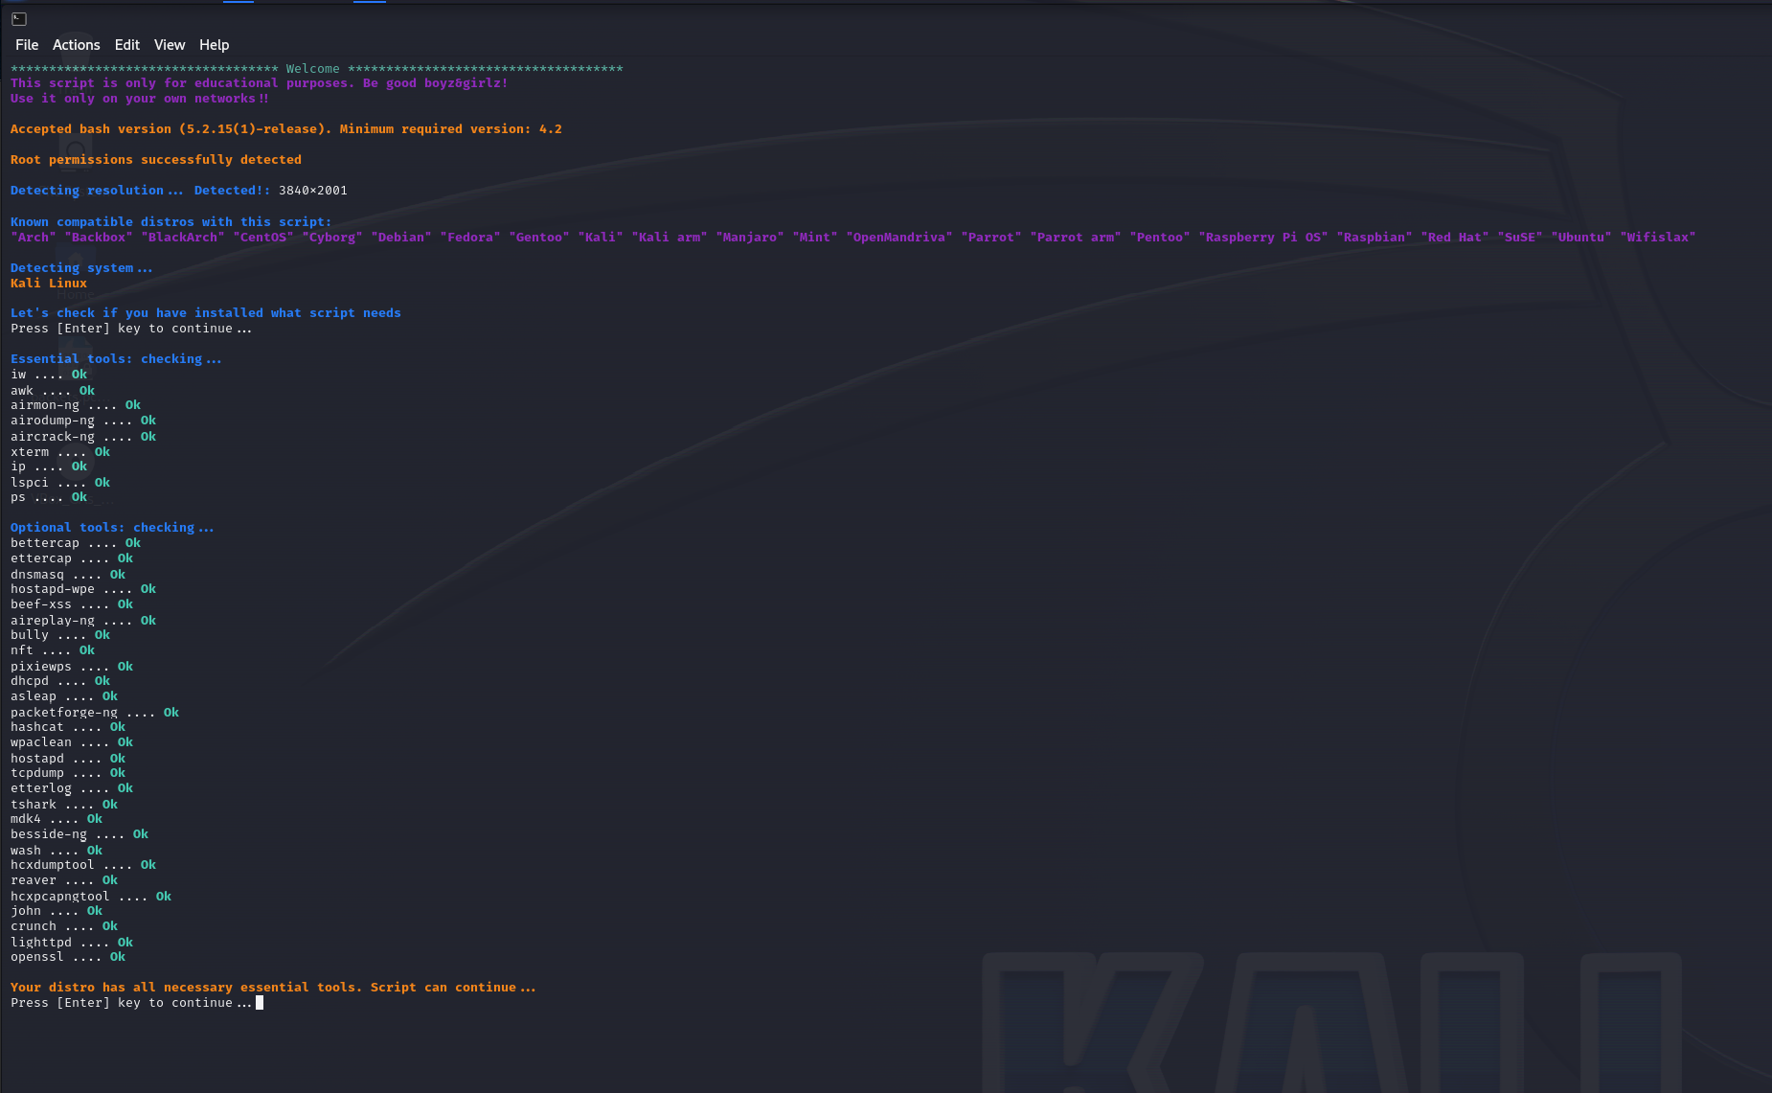
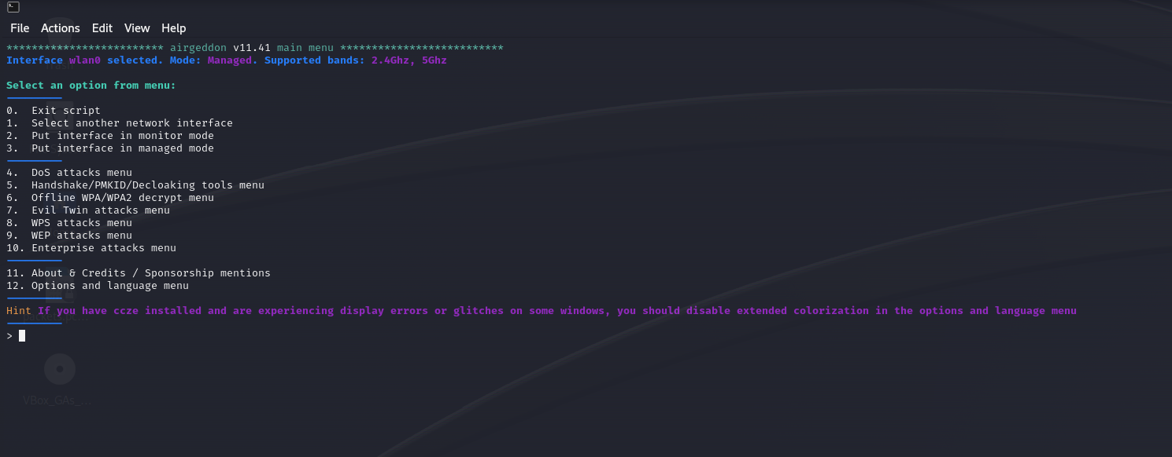

Slide 6
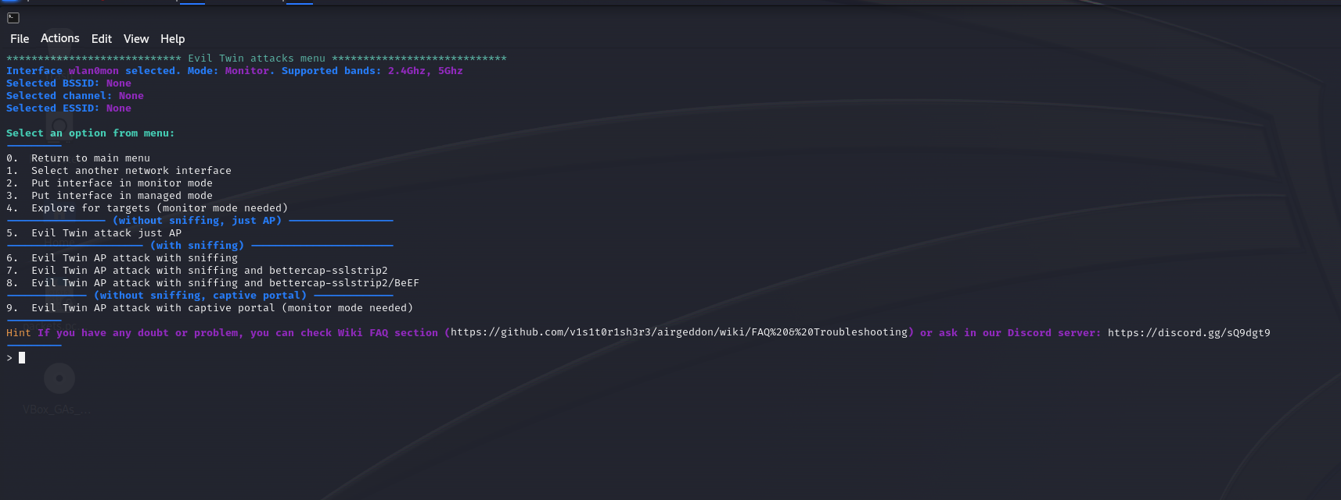
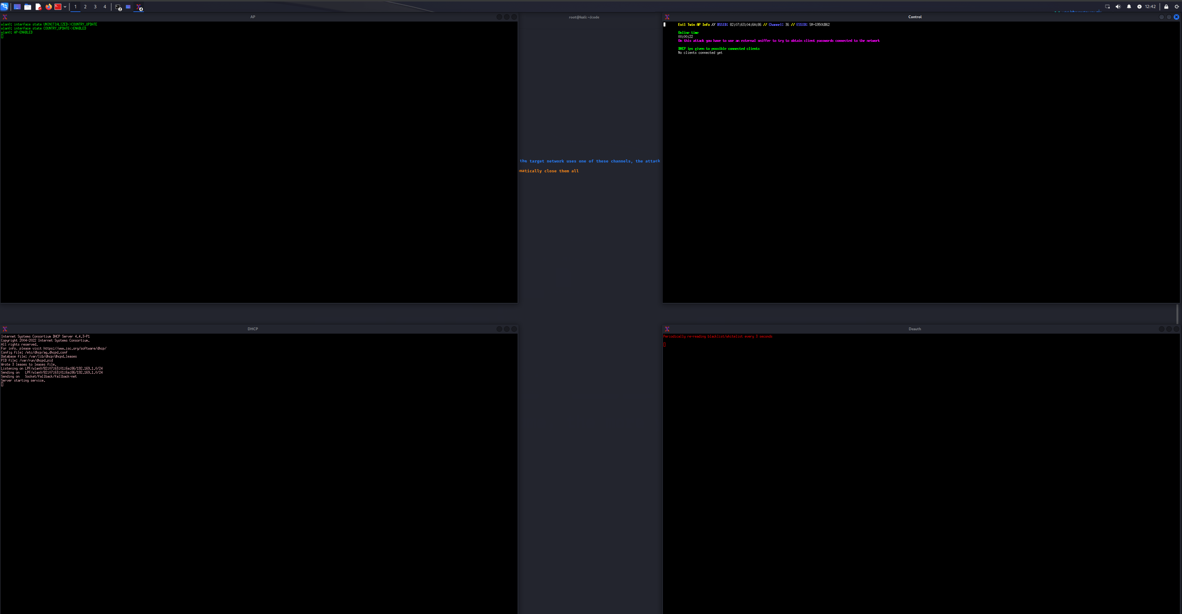

Slide 7
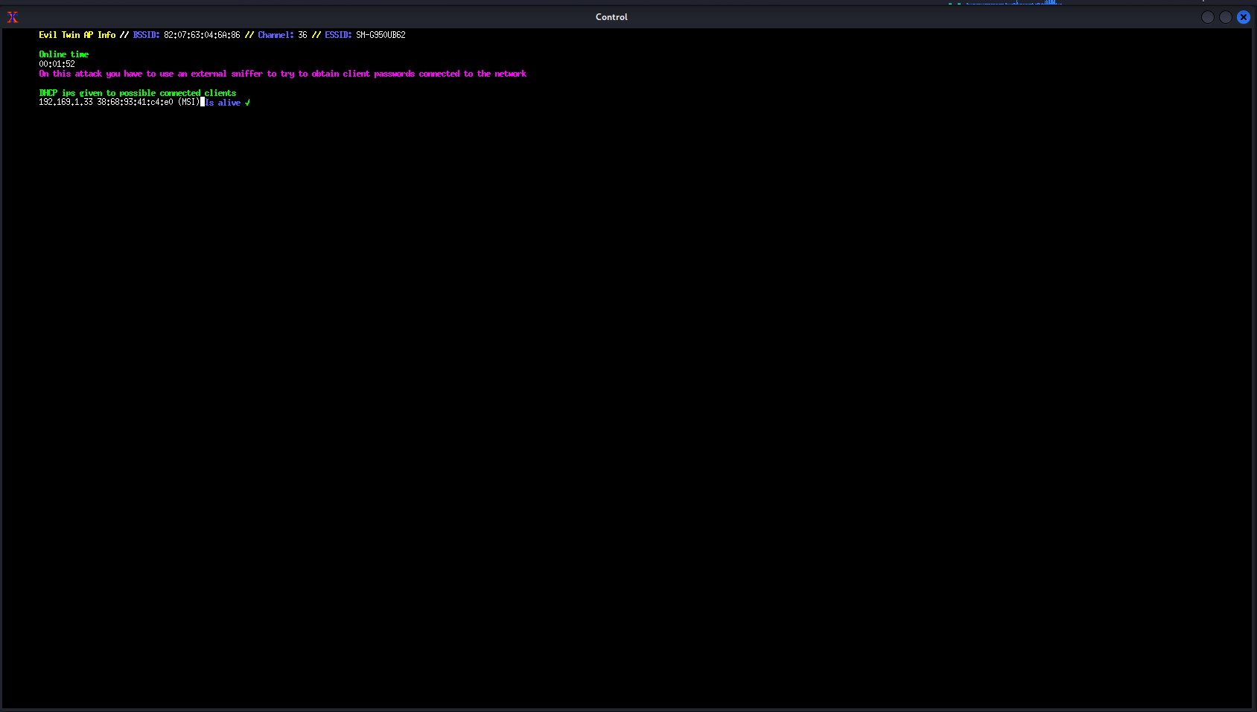
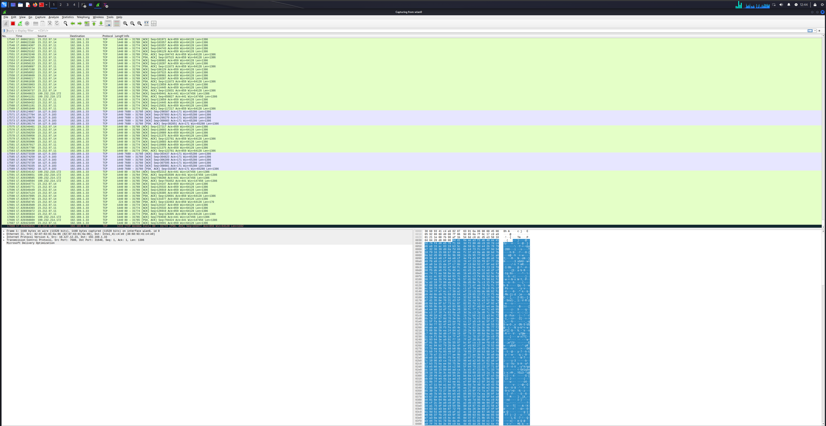

Slide 8
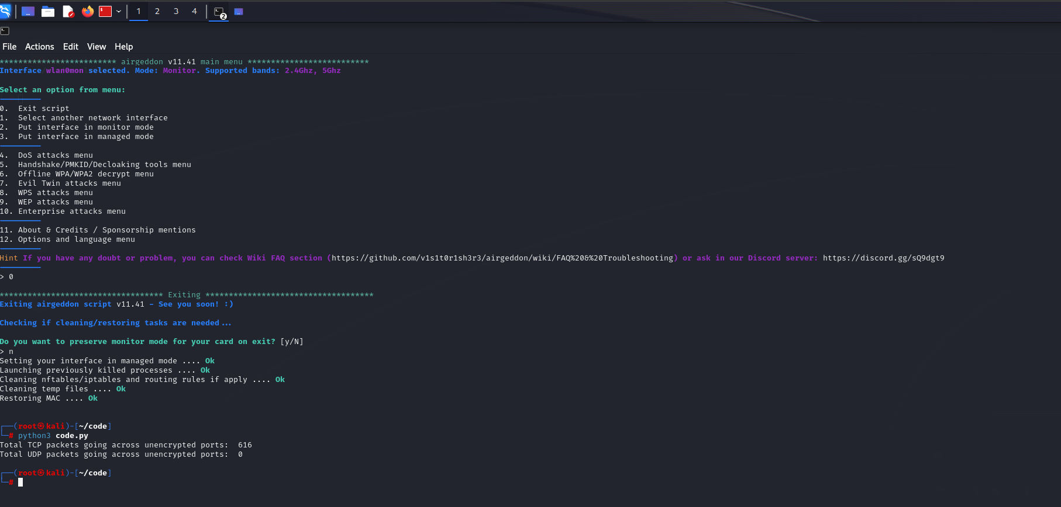
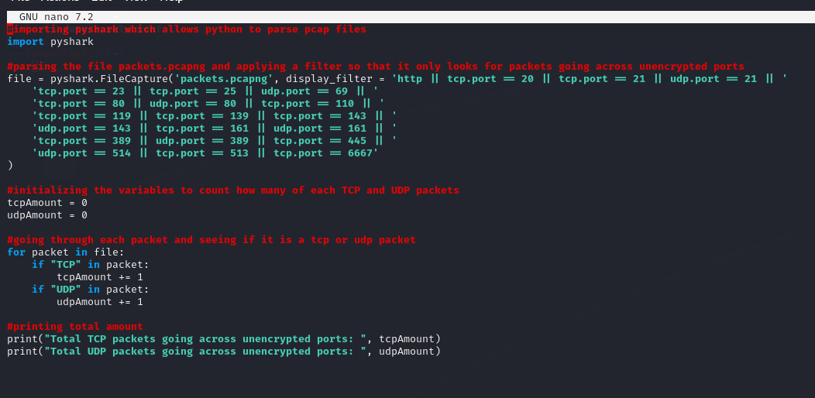

Slide 9
Test Cases
Test Plan
  The test was to be over a small private network
  The final test was to do it over the CSU wireless network

Slide 10
Test Results
Test 1 – 3
  Fail
  Coult not connect to AP
  Problem solved by reverting to Kali 2023.2
Test 4-5
  Pass
  Both singular and multiple connections were allowed

Slide 11
Challenges Overcome
Kali Kernel > 6.1 does not work
  No error messages or logs
Did not know about the list for USB WIFI adapters
  Spent over $100

Slide 12
Future Upgrades
Get a second USB wifi adapter for channel hopping
Create a better Python script to collect more data
Increase data collected

Slide 13
Links
Repo
  https://github.com/TWHamiltonJR/CSU-Senior-Project/tree/master
Tests
  https://github.com/TWHamiltonJR/CSU-Senior-Project/tree/master/tests

